Slide 1
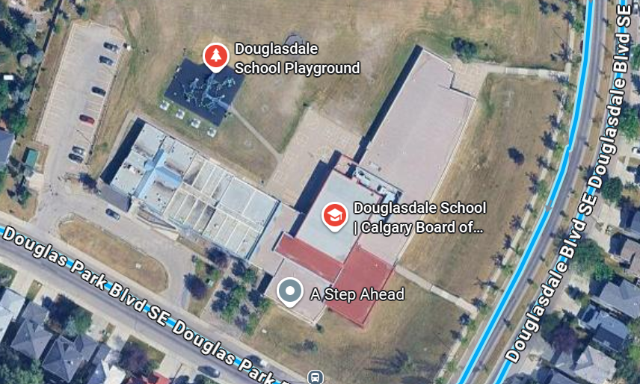
Grade 4 meet here
Grade 5 meet here
Grade 2 meet here
Grade 1 and 3 meet here
Kindergarten meet here
Late arrivals enter through school office.

